Slide 1
테스트 코드 리팩토링
2014.12.02

Slide 2
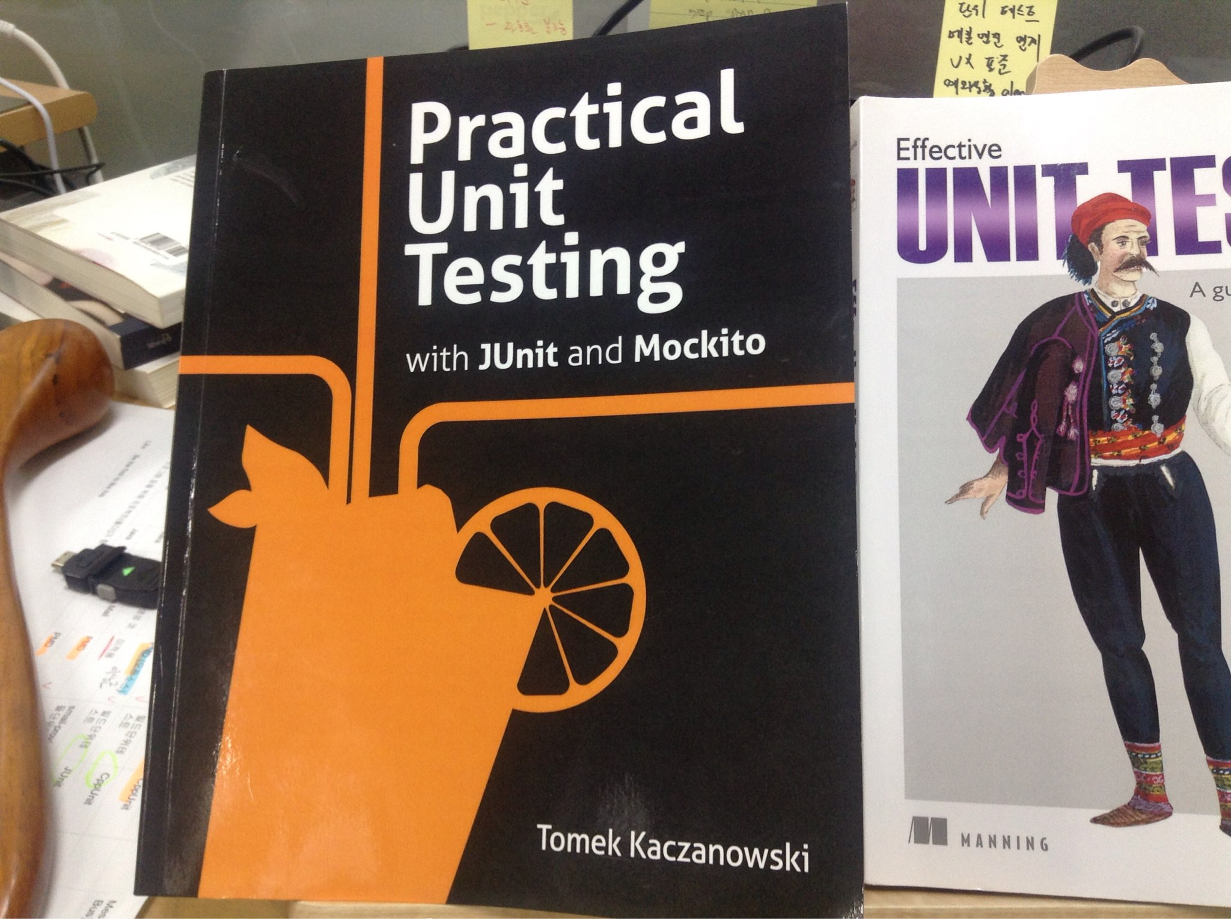
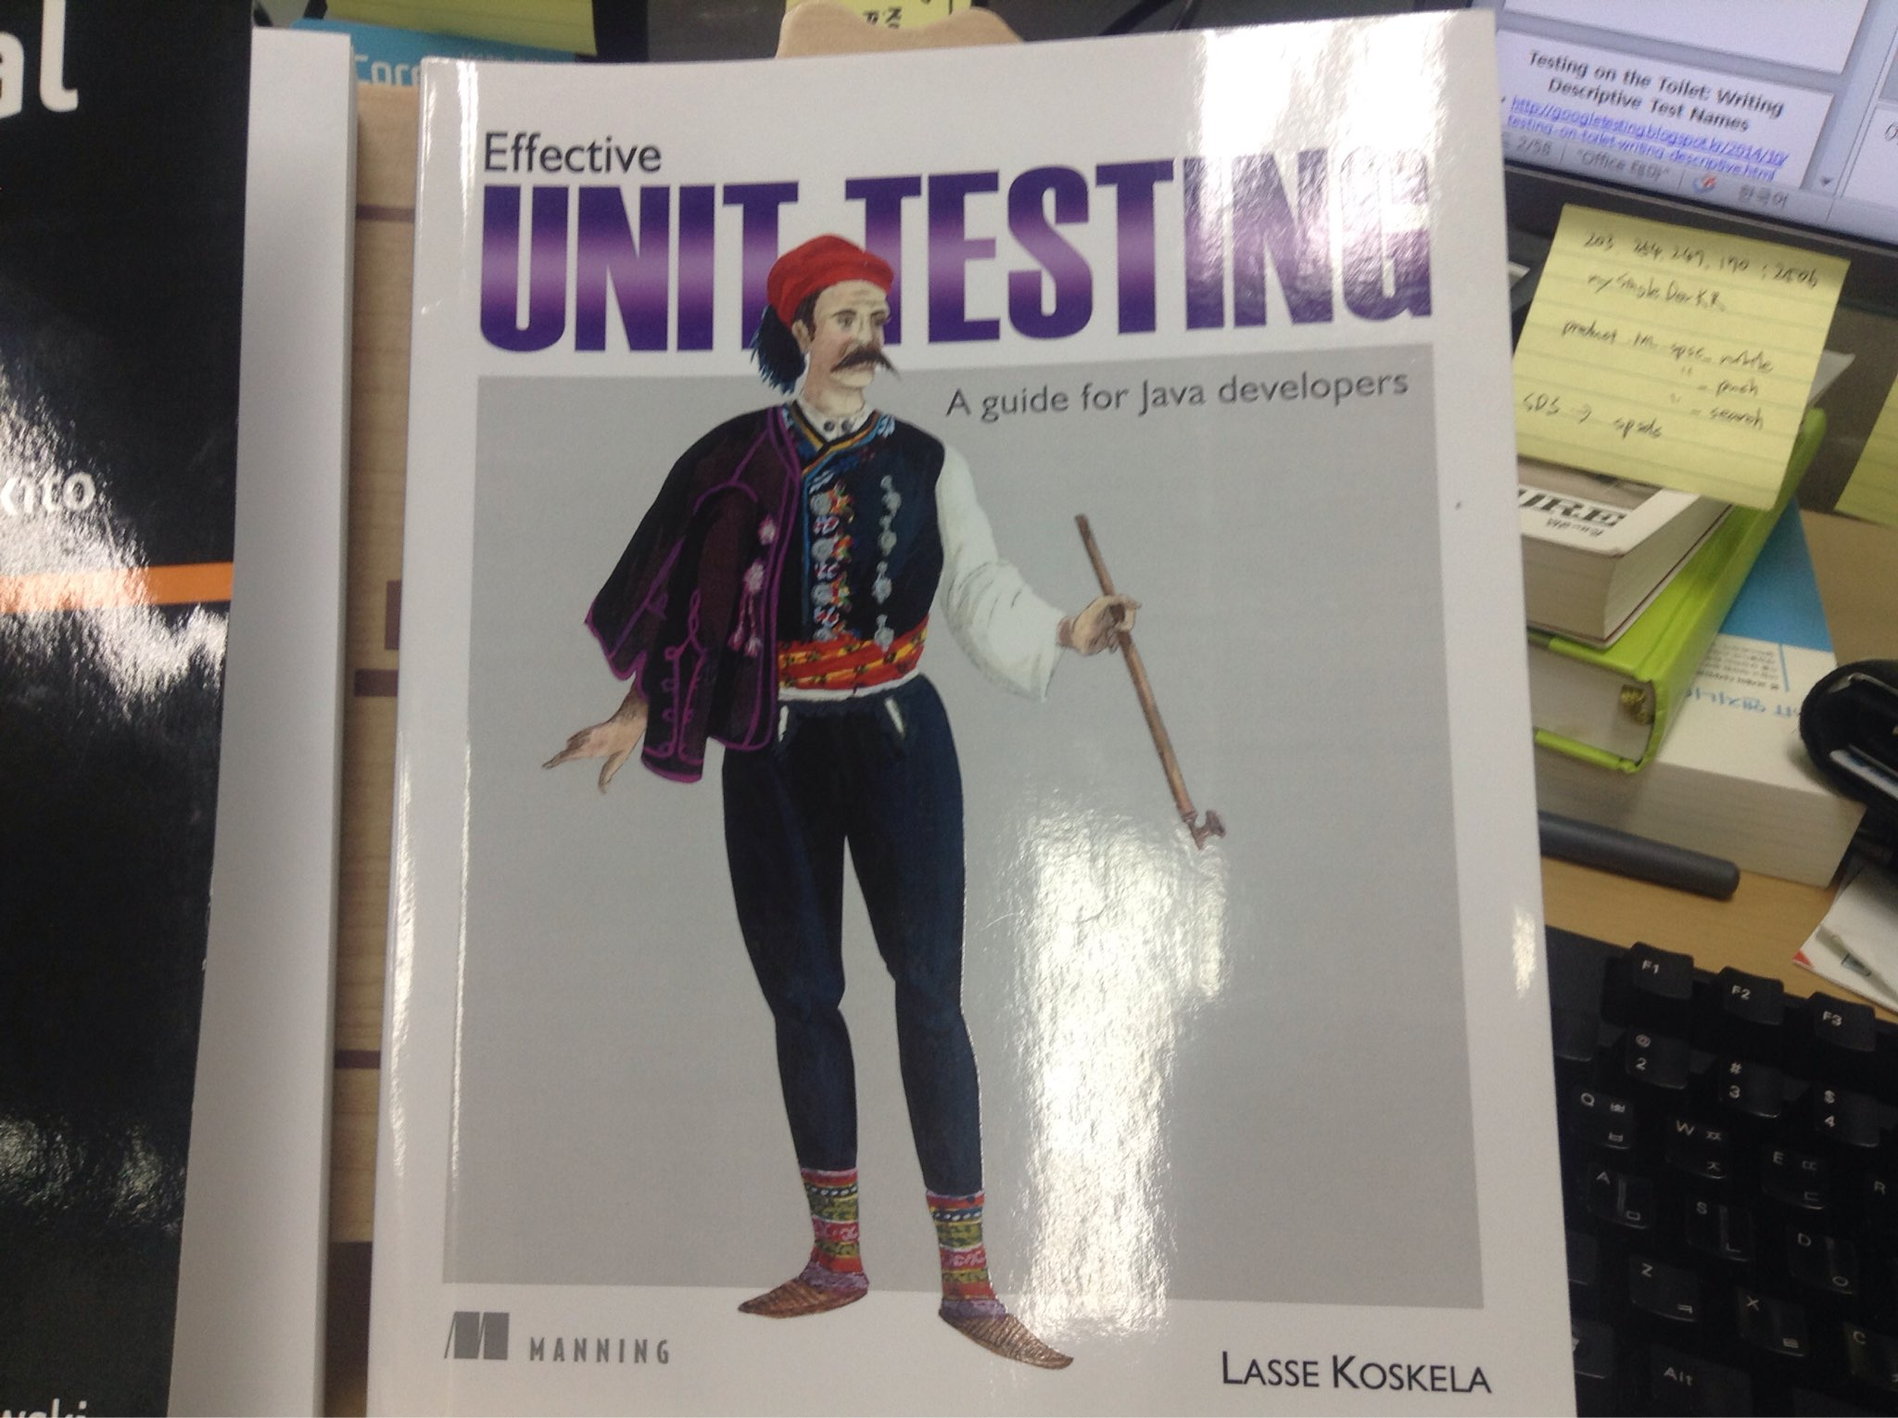

Slide 3
Tools
Matcher Libraries
FEST
Hamcrest
JUnitParams
parameterized tests
EasyTest
parameterized tests
Utilities
Catch-Exception
Tempus-Fugit
Unitils

Slide 4
목적
Readability
Maintainability
왜 실패인지를 빠르게 파악하기
수행속도 단축
테스트 결과(Jenkins Log)만 가지고 무슨 문제인지 파악 가능

Slide 5
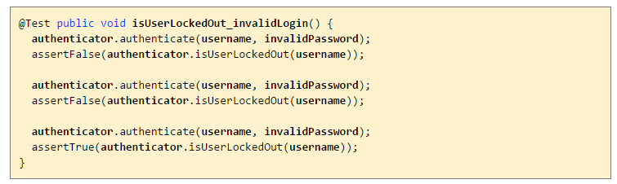
Testing on the Toilet: Writing Descriptive Test Names
http://googletesting.blogspot.kr/2014/10/testing-on-toilet-writing-descriptive.html
@Test
public void isUserLockedOut_lockOutUserAfterThreeInvalidLoginAttempts ()

Slide 6
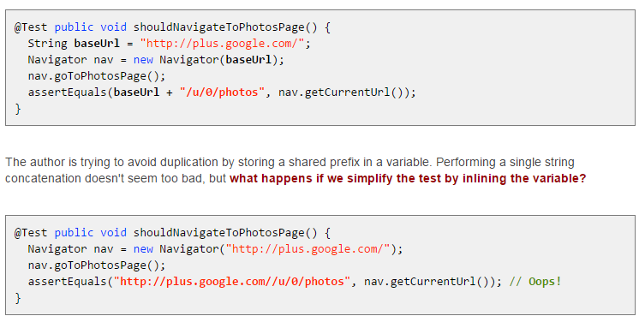
Don't Put Logic in Tests
http://googletesting.blogspot.kr/2014/07/testing-on-toilet-dont-put-logic-in.html
When tests do need their own logic, such logic should often be moved out of the test bodies and into utilities and helper functions.

Slide 7
테스트 수행 속도 개선
Multiple Jenkins jobs
메소드 병행 수행
@RunWith(ConcurrentTestRunner.class)
메일 수신 확인 sleep time 줄이기
sleep time 변수처리
통합 시 shorter sleep time 사용

Slide 8
개발 디버깅 지원
가능한 수신 확인과 다른 동작(필터링 등) 확인을 분리한다.
timeout fail 이 발생하면 수신이 안되는 건지 다른 동작이 안되는 건지 쉽게 파악할 수 없음
자동분류에서는 어쩔 수 없고...
문제가 되는 mail id 출력

Slide 9
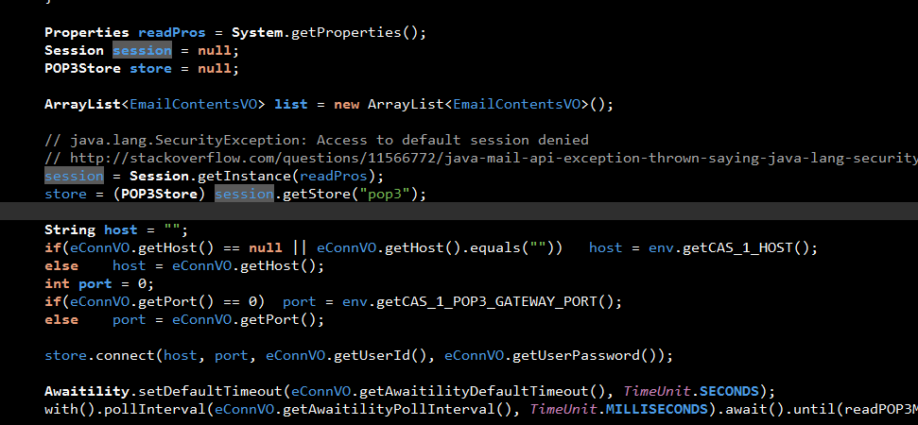
변수 선언과 assign을 붙이기
Session session = Session.getInstance(readPros);

Slide 10
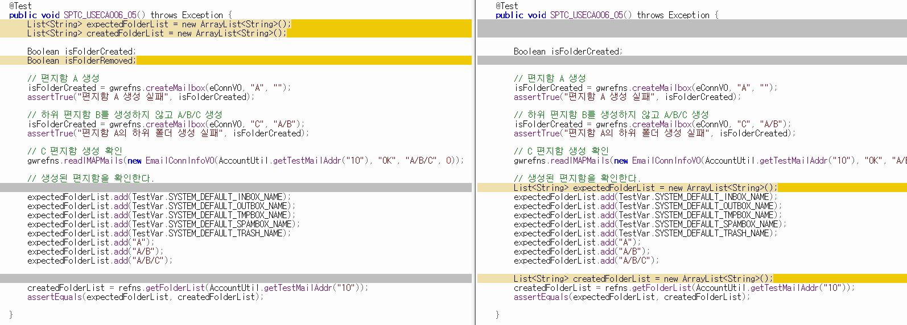
변수 선언과 assign을 붙이기

Slide 11
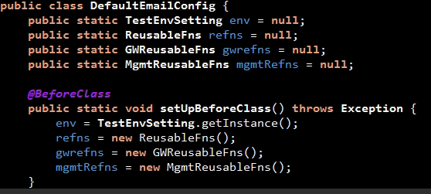
변수 선언과 assign을 붙이기

Slide 12
불필요한 메모리 할당

Slide 13
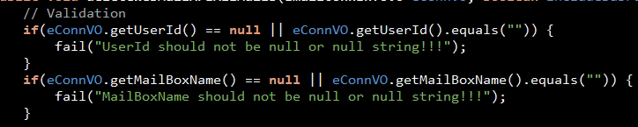
Test Input Validation
fail()
new Exception Type
e.g. TestInputException

Slide 14
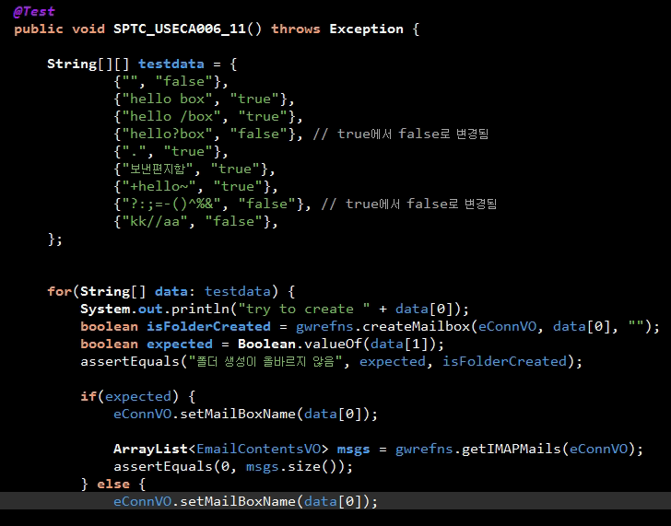
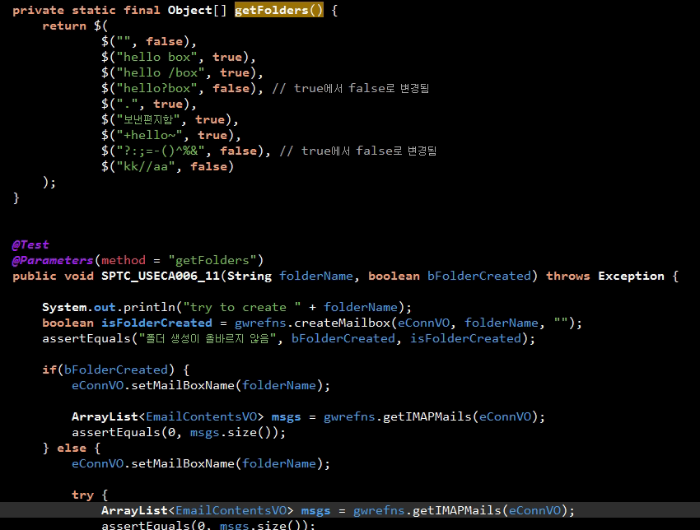
Parameterized Test
단점
- For each row, the setUp method is executed.

Slide 15
Parameterized Test
none of one’s own, potentially flawed, logic is introduced (e.g. for loop)
add another set of arguments is very easy, and does not make it code grow
a single data-providing method can be used to feed multiple test methods, making the code even more concise
there is no copy&paste coding, there are no “global” variables, and the DRY principle is faithfully honored
there is a clear separation between test logic (how the code is expected to work) and test dat (what values are tested)
we get more detailed results of the tests’ execution

Slide 16
Expected Exception
@Test(expected = ExceptionClass.class)
try-catch 사용
exception message verification 가능
Catch-Exception Library - BDD style
중요!!!
meaningful names to methods and variables

Slide 17
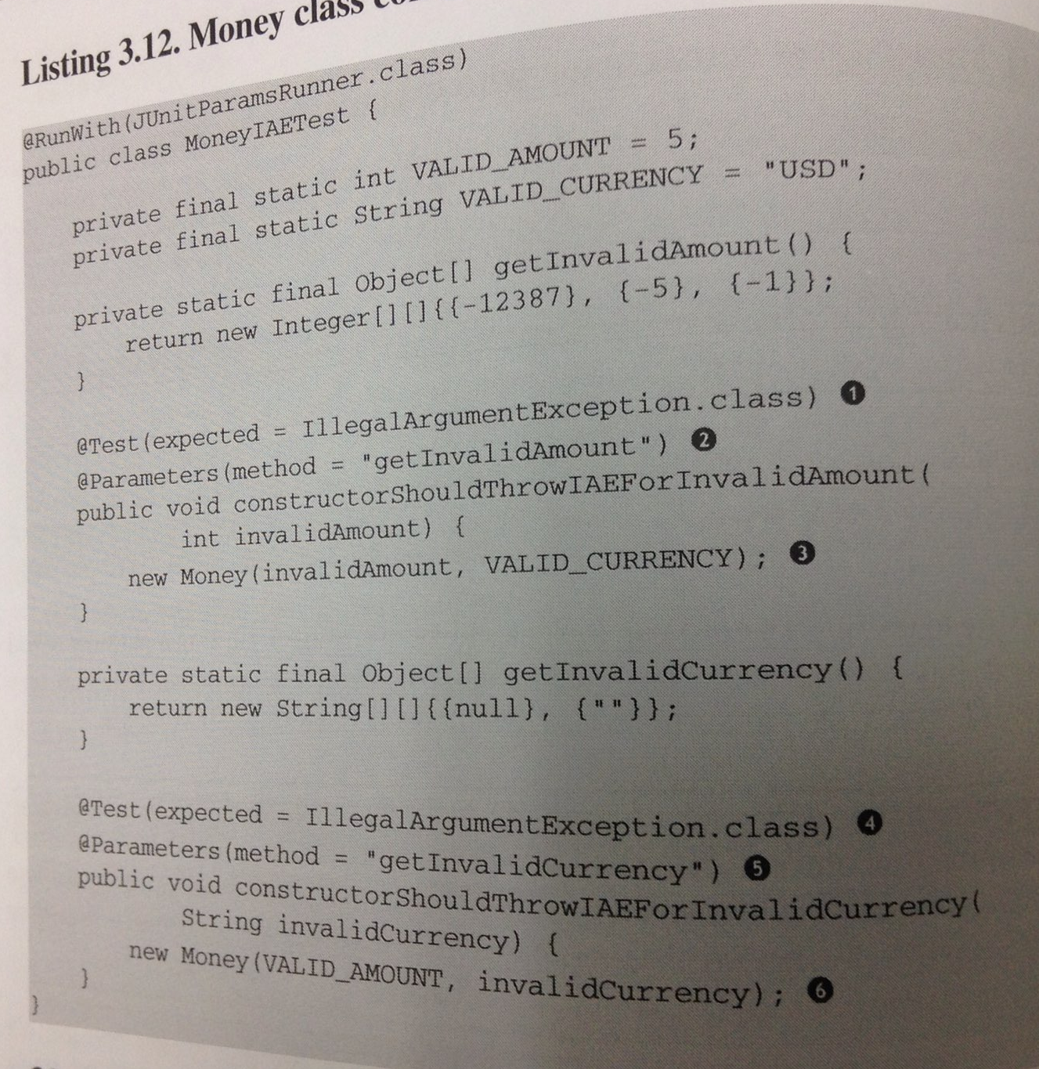
Checking Expected Exceptions

Slide 18
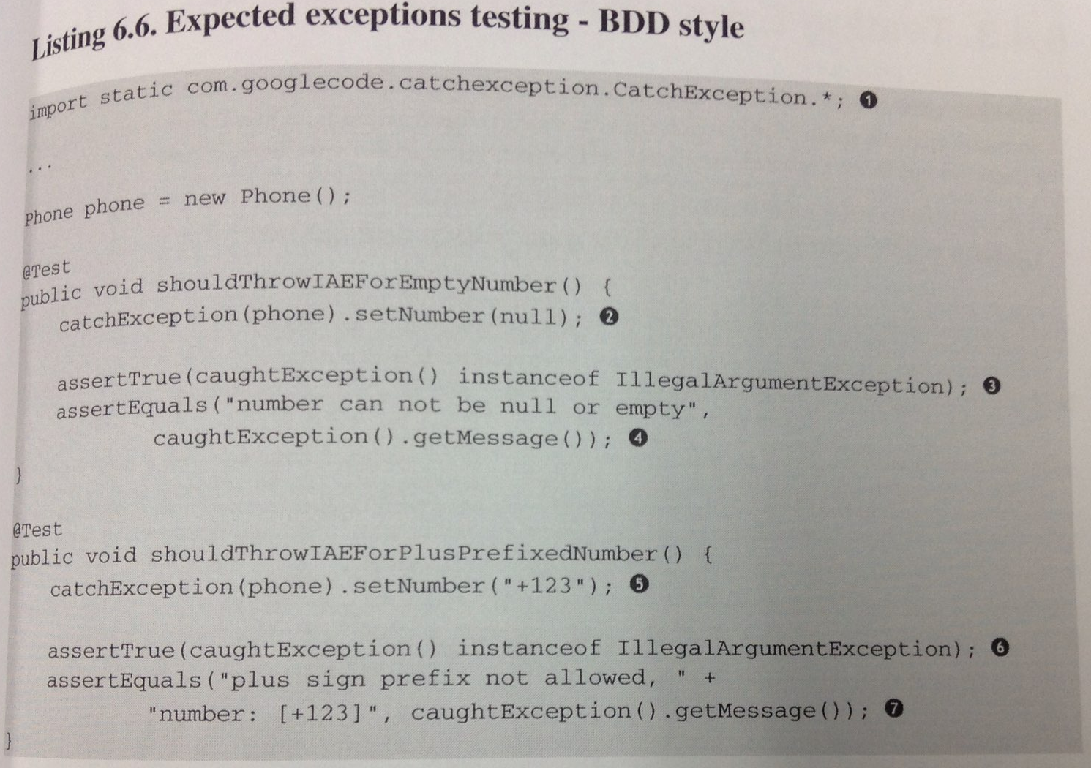
Catch-Exception Library

Slide 19
Test Fixture Setting
Test Fixture in Every Test Method
JUnit Execution Model
Client object as an instance field
Annotations for Test Fixture Creation
@Before, @BeforeClass

Slide 20
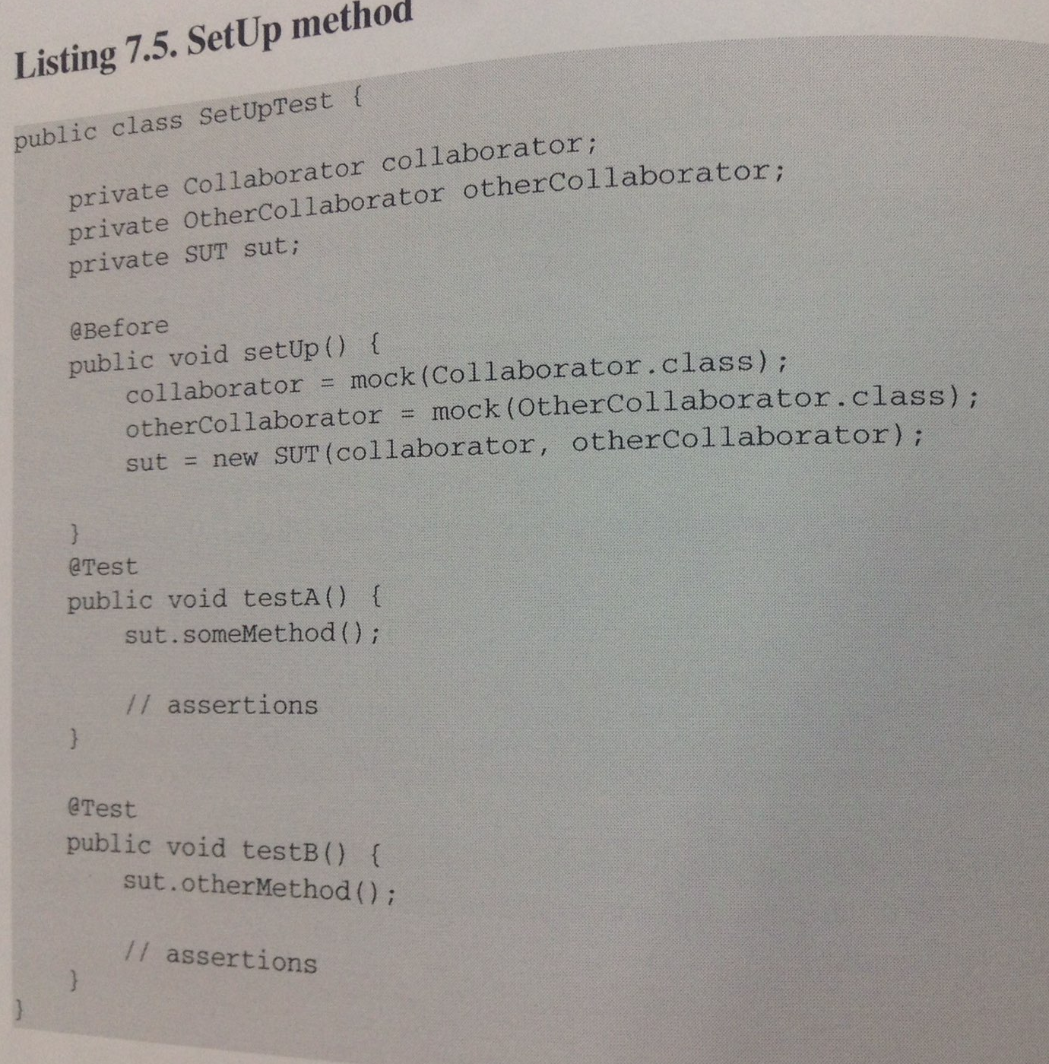

Slide 21
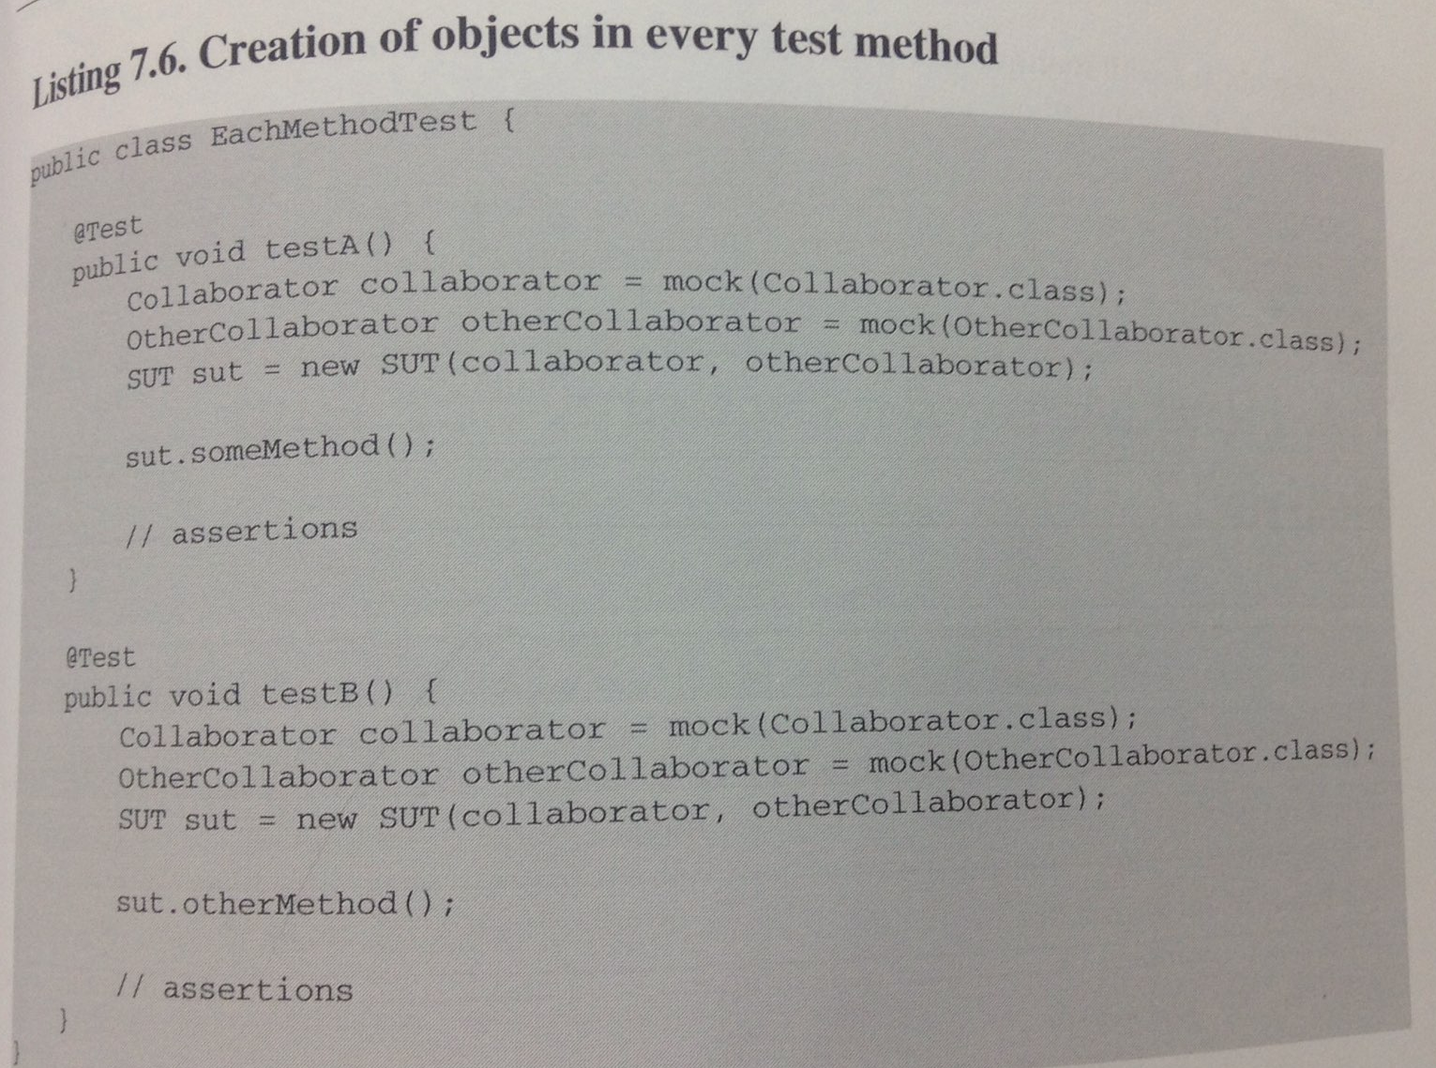

Slide 22
asserThat()
More readable test code
Matcher 라이브러리
FEST
Hamcrest
import 주의
import static org.junit.Assert.assertEquals;
import static org.junit.Assert.assertFalse;
import static org.junit.Assert.assertTrue;
import static org.junit.Assert.fail;
import static org.fest.assertions.Assertions.*;

Slide 23
Advantages of Matchers
they enhance code readability
they help us to write assertions on the right abstraction level
they help to remove logic from tests
they are highly reusable, which is very important if your domain objects are complex and are tested with multiple test scenarios
many matchers are available directly from matcher libraries
writing custom matchers is a relatively simple task

Slide 24
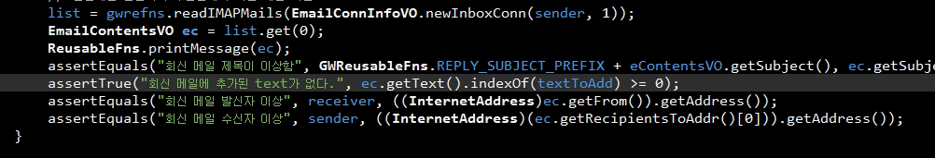
String 포함 여부

Slide 25
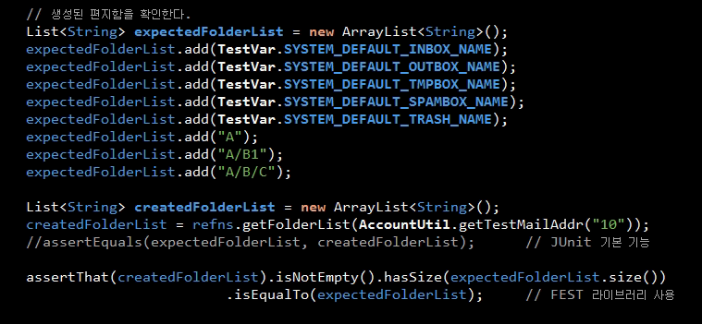
Testing Collections Using Matchers

Slide 26
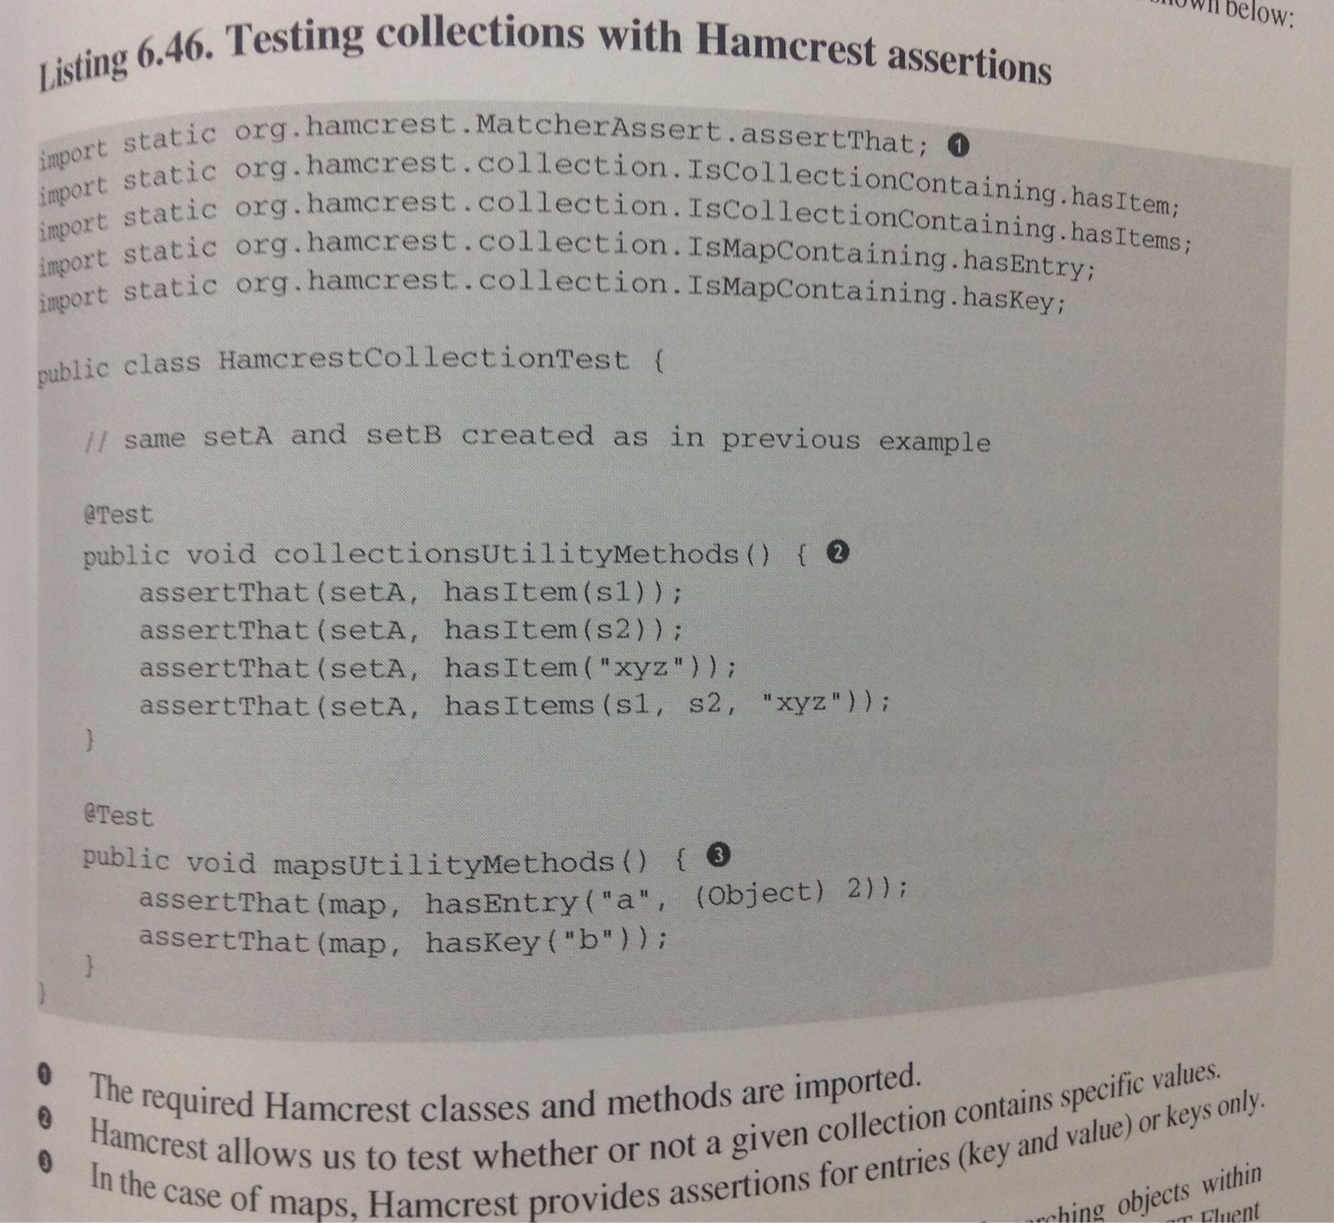

Slide 27
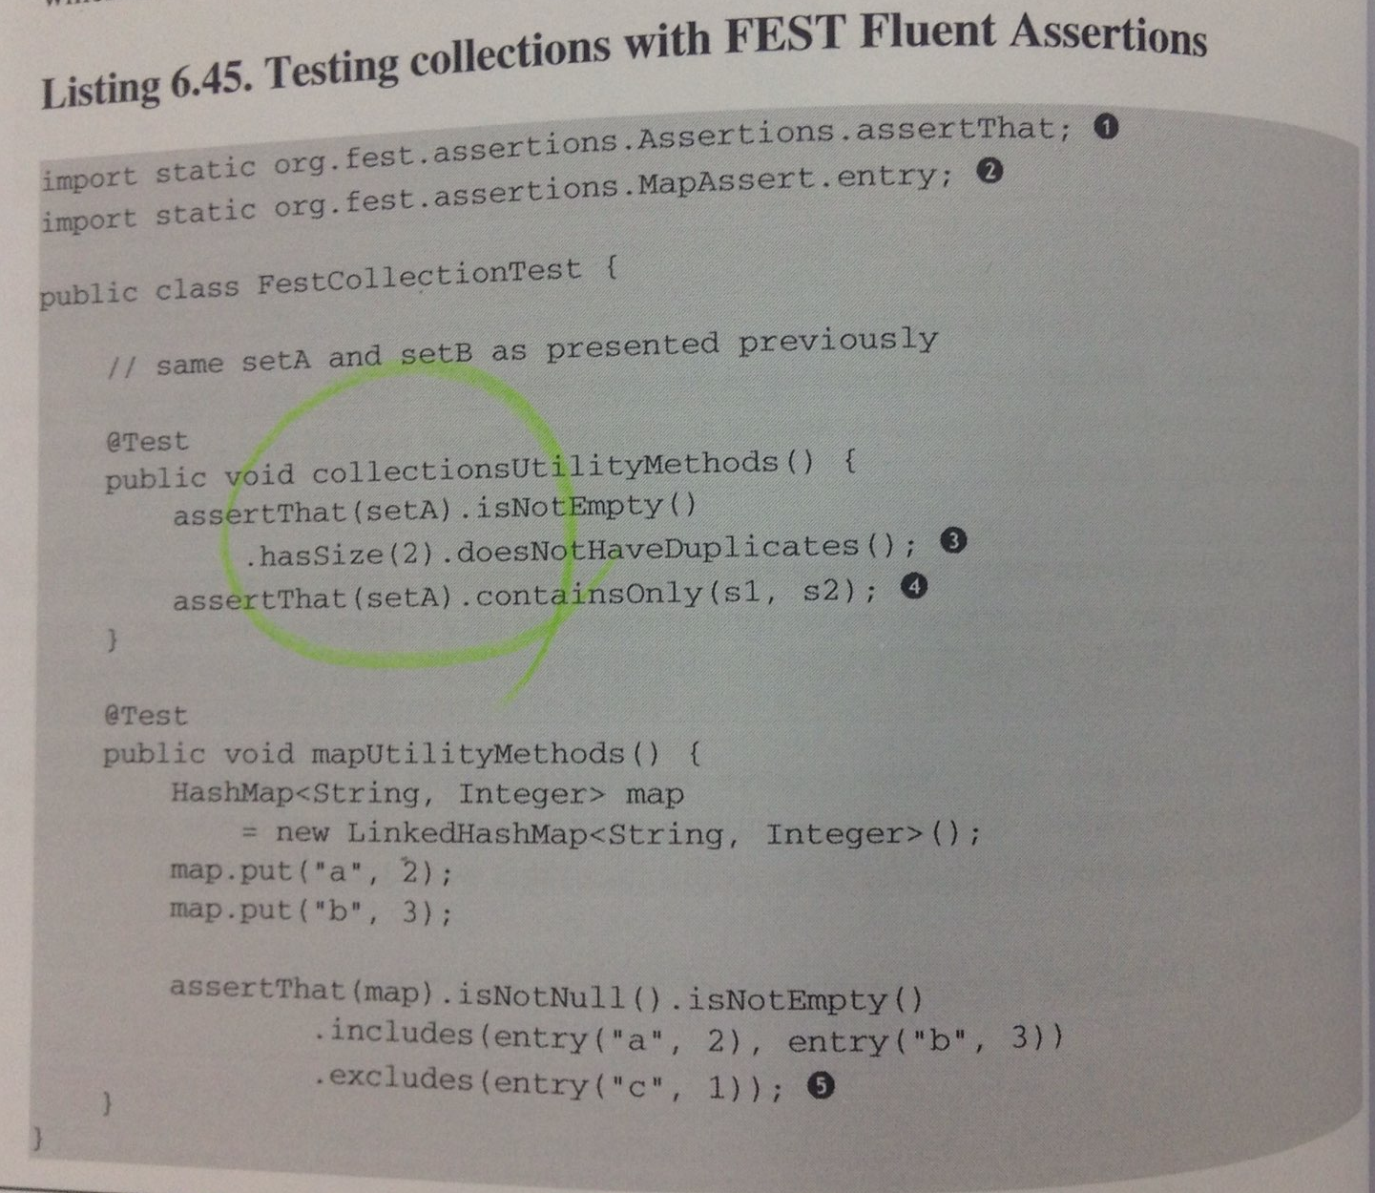

Slide 28
Rules
잘 쓰이지는 않는다고 함
ErrorCollector: collect multiple errors in one test method
ExepctedException: make flexible assertions about thrown exceptions
ExternalResource: start and stop a server
TemporaryFolder: create fresh files, and delete after test
TestName: remember the test name for use during the method
TestWatcher
Timeout
Verifier: fail test if object state ends up incorrect

Slide 29
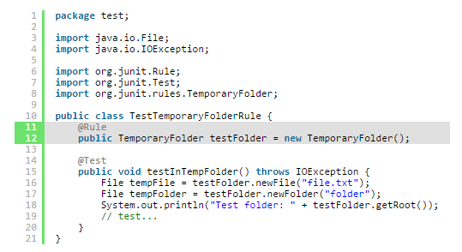
TemporaryFolder

Slide 30
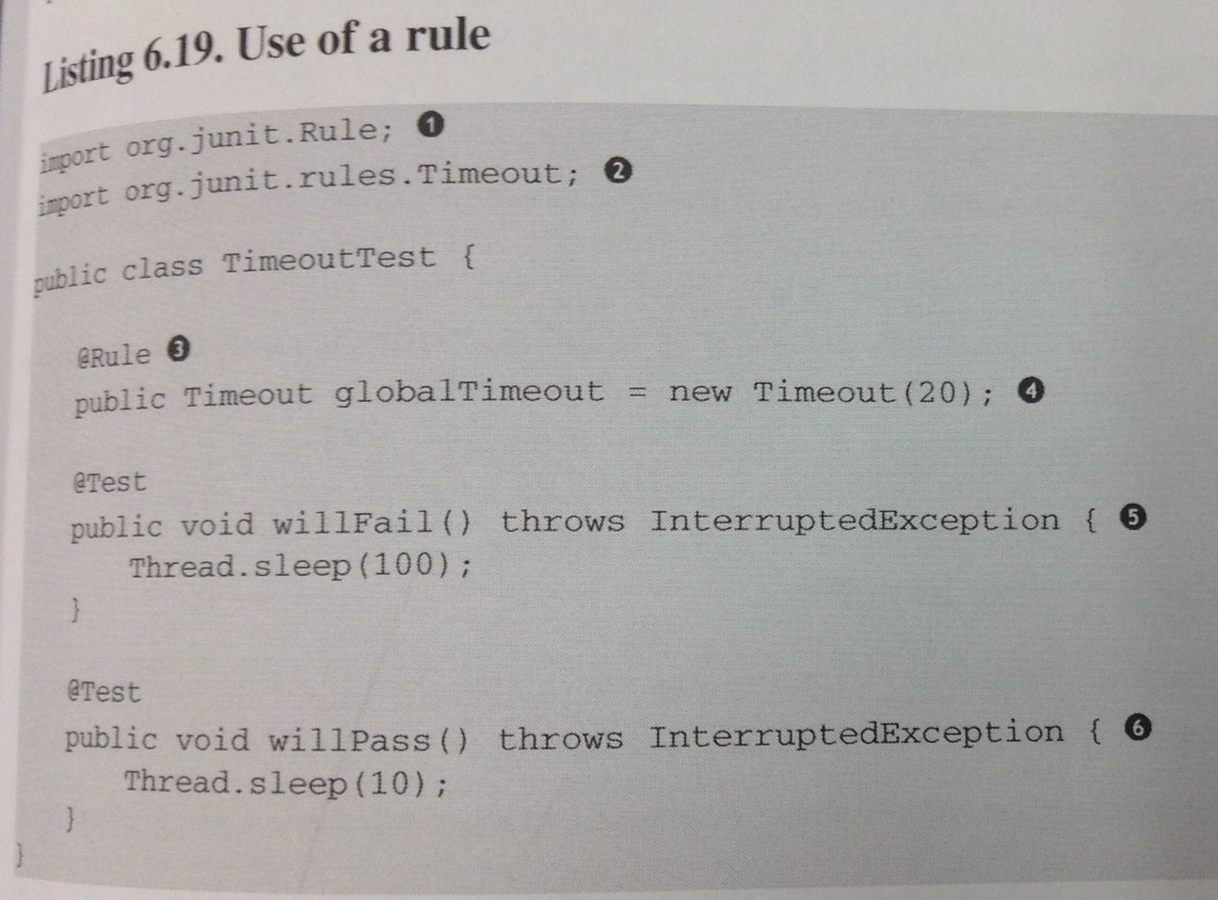
Timeout

Slide 31
Asynchronous
Awaitility
비동기를 동기로 변경
how to ???

Slide 32
Points Of Controversy
Access Modifiers
Random Values in Tests
Is Set-up the Right Thing for You?
How Many Assertions per Test Method?
Private Methods Testing
New Operator
Capturing Arguments to Collaborators

Slide 33
Random Values in Tests
does not automatically make the test suite stronger
complicates tests and give rise to a number of issues

Slide 34
Is Set-up the Right Thing for You?
The DRY principle
The readability of tests
Consistency

Slide 35
How Many Assertions per Test Method?
OAPTM (One Assertion Per Test Method)
each test method should concentrate on a single feature of the SUT.

Slide 36
Maintainable Tests
Test Behavior, not Methods
Complexity Leads to Bugs
Do not put any complexity into your tests!
No if, no switch, no decision making
the quality of the logic of production code and the quality of the logic of test code
Rewriting Tests when the Code Changes

Slide 37
Rewriting Tests when the Code Changes
(테스트 코드 quality) 문제가 될 때
리팩토링 했는데 테스트가 실패함
변경한 기능과는 상관없는 테스트가 실패함
a single change results in many tests failing
테스트 중복
위에서 첫번째, 두번째 이슈가 심각함
We should write tests which verify the expected outcome of systems behavior

Slide 38
Avoid Overspecified Tests
Specify exactly what you want to happen and no more
a test is overspecified if it verifies some aspects which are irrelevant to the scenario being tested

Slide 39
Commented-out Tests
Trustworthiness
Delete it.

Slide 40
Misleading comments
Trustworthiness
Deleting a comments is almost always worth considering
Replace the comment with better names for variables and methods
Extract a method from that commented block of code and name it well

Slide 41
Shallow Promises
Trustworthiness
Test doesn’t do anything.
Test doesn’t actually test anything.
Test isn’t as thorough as its name suggests.

Slide 42
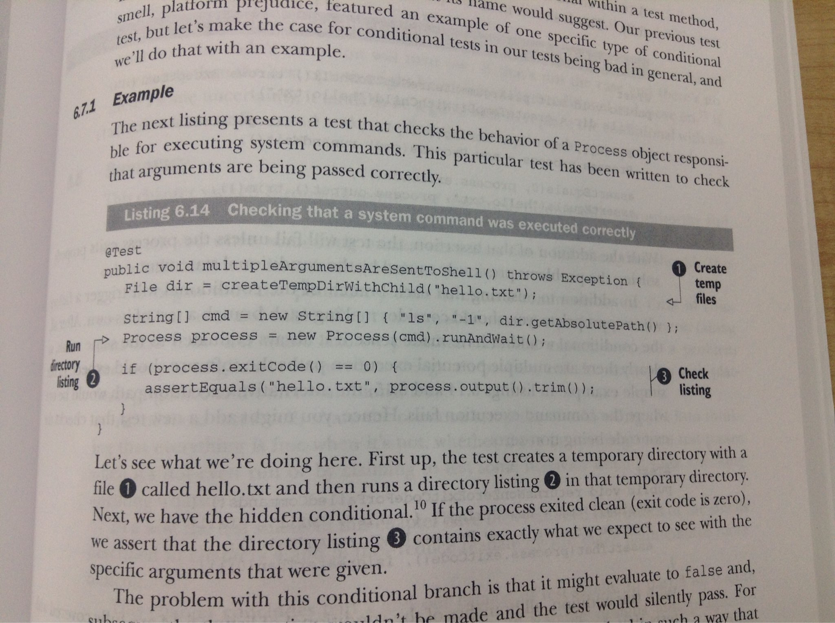
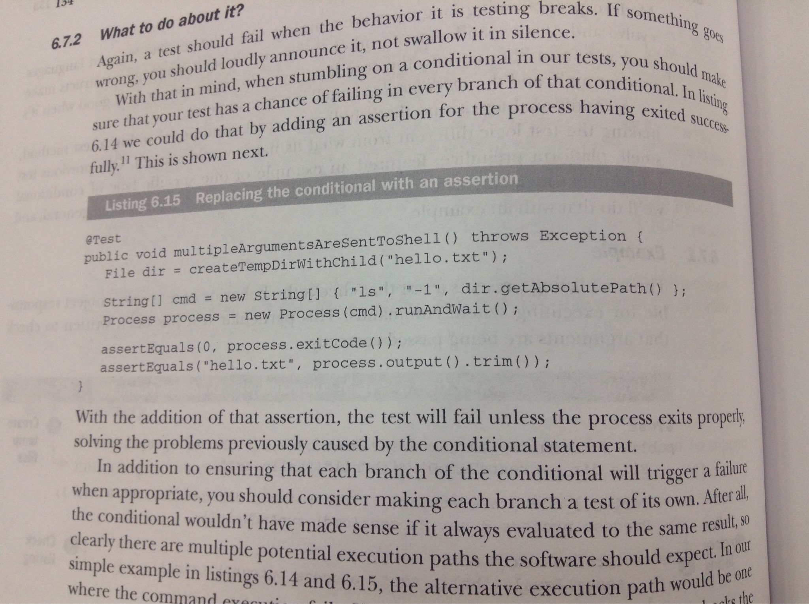
Conditional Tests
Trustworthiness

Slide 43
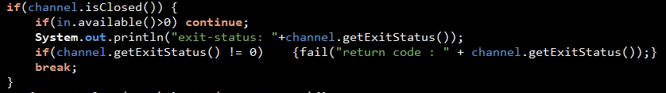
Conditional Tests
Trustworthiness

Slide 44
Test Quality
Code Coverage
Mutation Testing
Mutants
PIT Mutation Testing

Slide 45
Incidental Details
Readability
readable code
필요한 정보만 노출
첫 번째 방법
naming classes, methods, fields, variables
그 다음 방법
extract nonessential bits of code and information into private helpers and setup methods

Slide 46
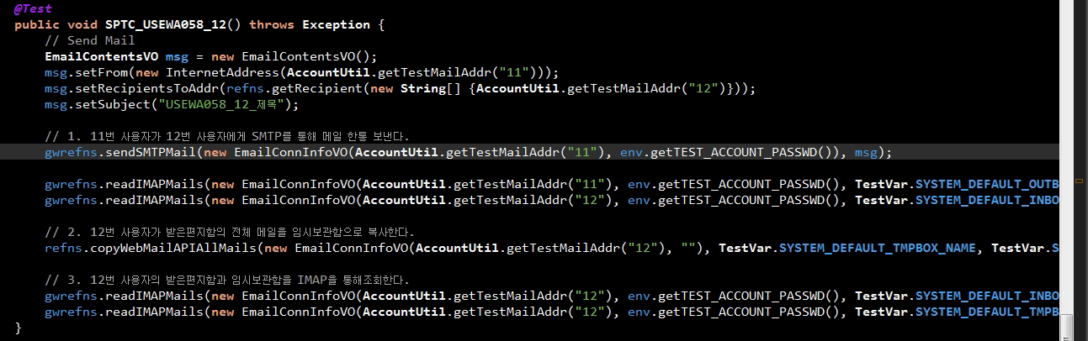
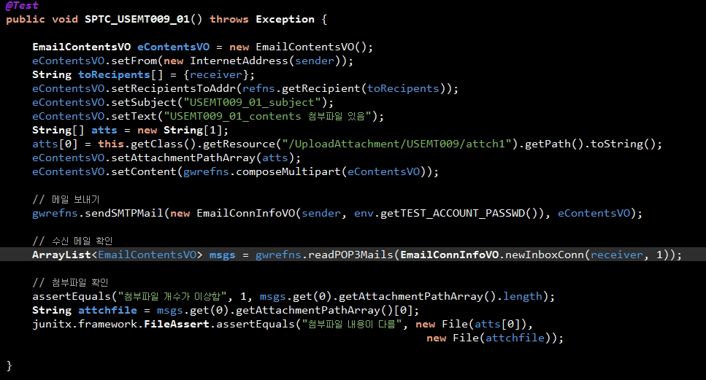
Readability
- Incidental Details, Column limit, ...

Slide 47
4.4 Column limit: 80 or 100
https://google-styleguide.googlecode.com/svn/trunk/javaguide.html#s4.4-column-limit
Projects are free to choose a column limit of either 80 or 100 characters. Except as noted below, any line that would exceed this limit must be line-wrapped, as explained in Section 4.5, Line-wrapping.
Exceptions:
Lines where obeying the column limit is not possible (for example, a long URL in Javadoc, or a long JSNI method reference).
package and import statements (see Sections 3.2 Package statement and 3.3 Import statements).
Command lines in a comment that may be cut-and-pasted into a shell.

Slide 48
list = refns.readWebMailAPIMails(new EmailConnInfoVO(AccountUtil.getTestMailAddr("12"), "", TestVar.SYSTEM_DEFAULT_INBOX_NAME, 0));
list = refns.readWebMailAPIMails(AccountUtil.getTestMailAddr("12"), "", TestVar.SYSTEM_DEFAULT_INBOX_NAME, 0);
list = refns.assertInboxMailCount(AccountUtil.getTestMailAddr("12"), 0);

Slide 49
When to inline data or logic?
Readability
If it’s short, inline it
If it’s too long to keep inlined, stash it behind a factory method or a test data builder
If that feels inconvenient, pull it out into a separate file
the rule of thumb
inline logic or data inside the test that uses it

Slide 50
Overprotective Tests
Readability
@Test
public void count() {
Data data = project.getData();
assertNotNull(data);
assertEquals(4, data.count());
}
필요한 경우 (method chain)
assertEquals(4, data.getSummary().getTotal());
불필요한 assert

Slide 51
Helper Function
Sometimes helper methods prove to be useful outside of test code, too, and find their way into becoming part of the production code. It happens.
SMailService class

Slide 52
Duplication
Maintainability
one of the most common code smells.
public class TemplateTest {
@Test
public void emptyTemplate() throws Exception {
assertEquals(“”, new Template(“”).evaluate());
}
@Test
public void plainTextTemplate() throws Exception {
assertEquals(“plaintext”, new Template(“plaintext”).evaluate());
}
}
public class TemplateTest {
@Test
public void emptyTemplate() throws Exception {
assertTemplateRendersItself(“”);
}
@Test
public void plainTextTemplate() throws Exception {
assertTemplateRendersItself(“plaintext”);
}
private void assertTemplateRendersAsItself(String template) {
assertEquals(template, new TEmplate(template).evaluate());
}
}
choose to leave some duplication in place in favor of improve readability.

Slide 53
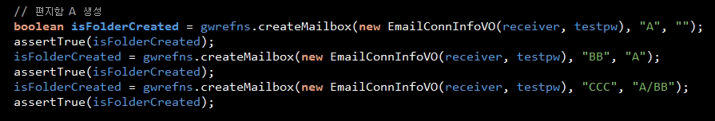
private void assertFolderCreatedSuccessfully(EmailConnInfoVO con, String folderName) {
boolean isFolderCreated = xxxx;
assertTrue(isFolderCreated);
}

Slide 54
EmailContentsVO 비교
Custom Matcher 구현
- subject, 수신자, 발신자 비교

Slide 55
본문 비교
assertEquals(1, refns.findMatchedCount(contentString, refns.getWebMailAPIContentString(new EmailConnInfoVO(AccountUtil.getTestMailAddr("11"), "", TestVar.SYSTEM_DEFAULT_TMPBOX_NAME, list.get(0).getMailSeq()))));
void assertContentsEquals(String expected, String actual) {
xxxxx
}

Slide 56
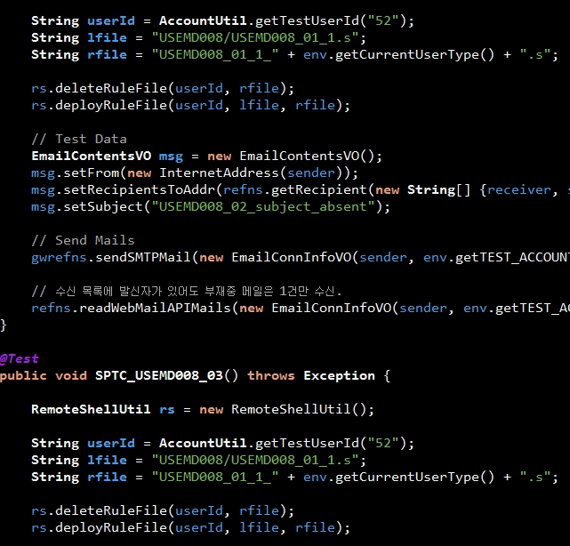

Slide 57
Big Duplication
ReusableFns 내 중복 함수
WASendReusableFns와 ReusableFns의 중복

Slide 58
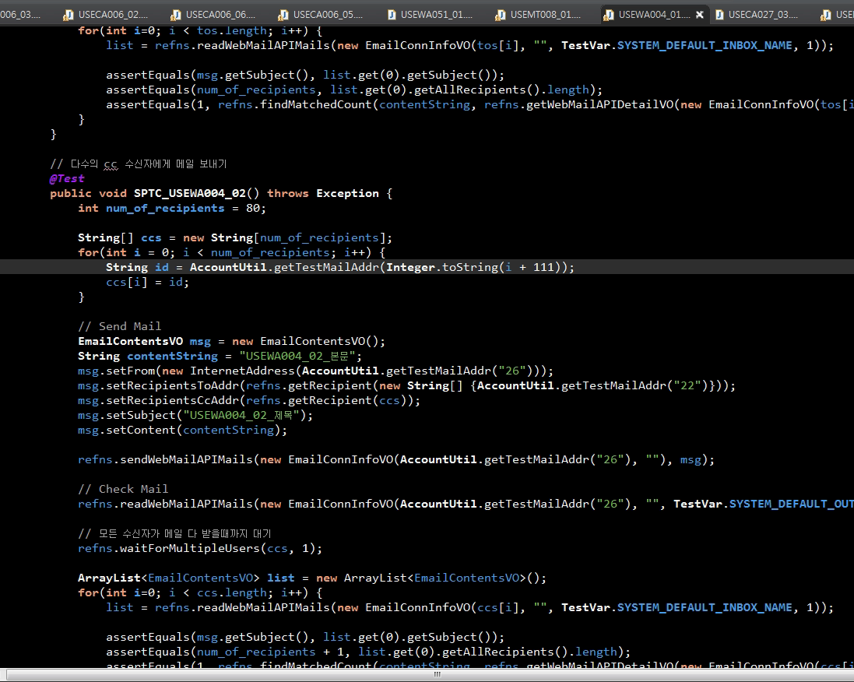

Slide 59
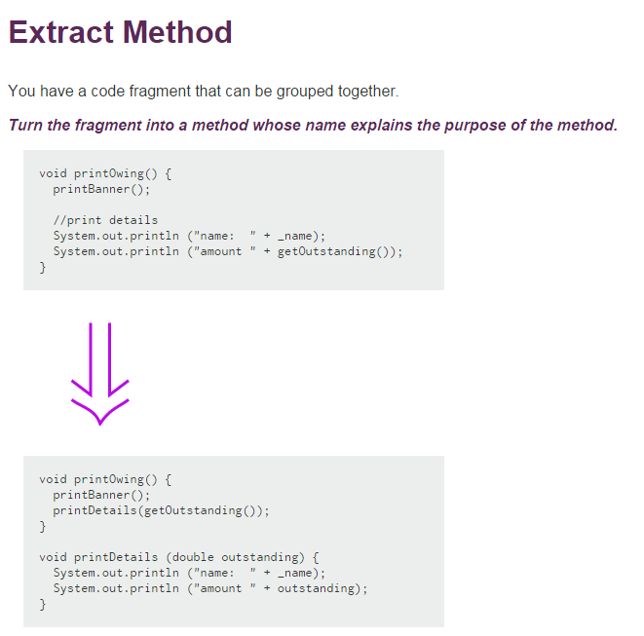
http://www.refactoring.com/catalog/extractMethod.html

Slide 60
Conditional Logic
Maintainability
should avoid if, else, for, while, switch in test methods

Slide 61
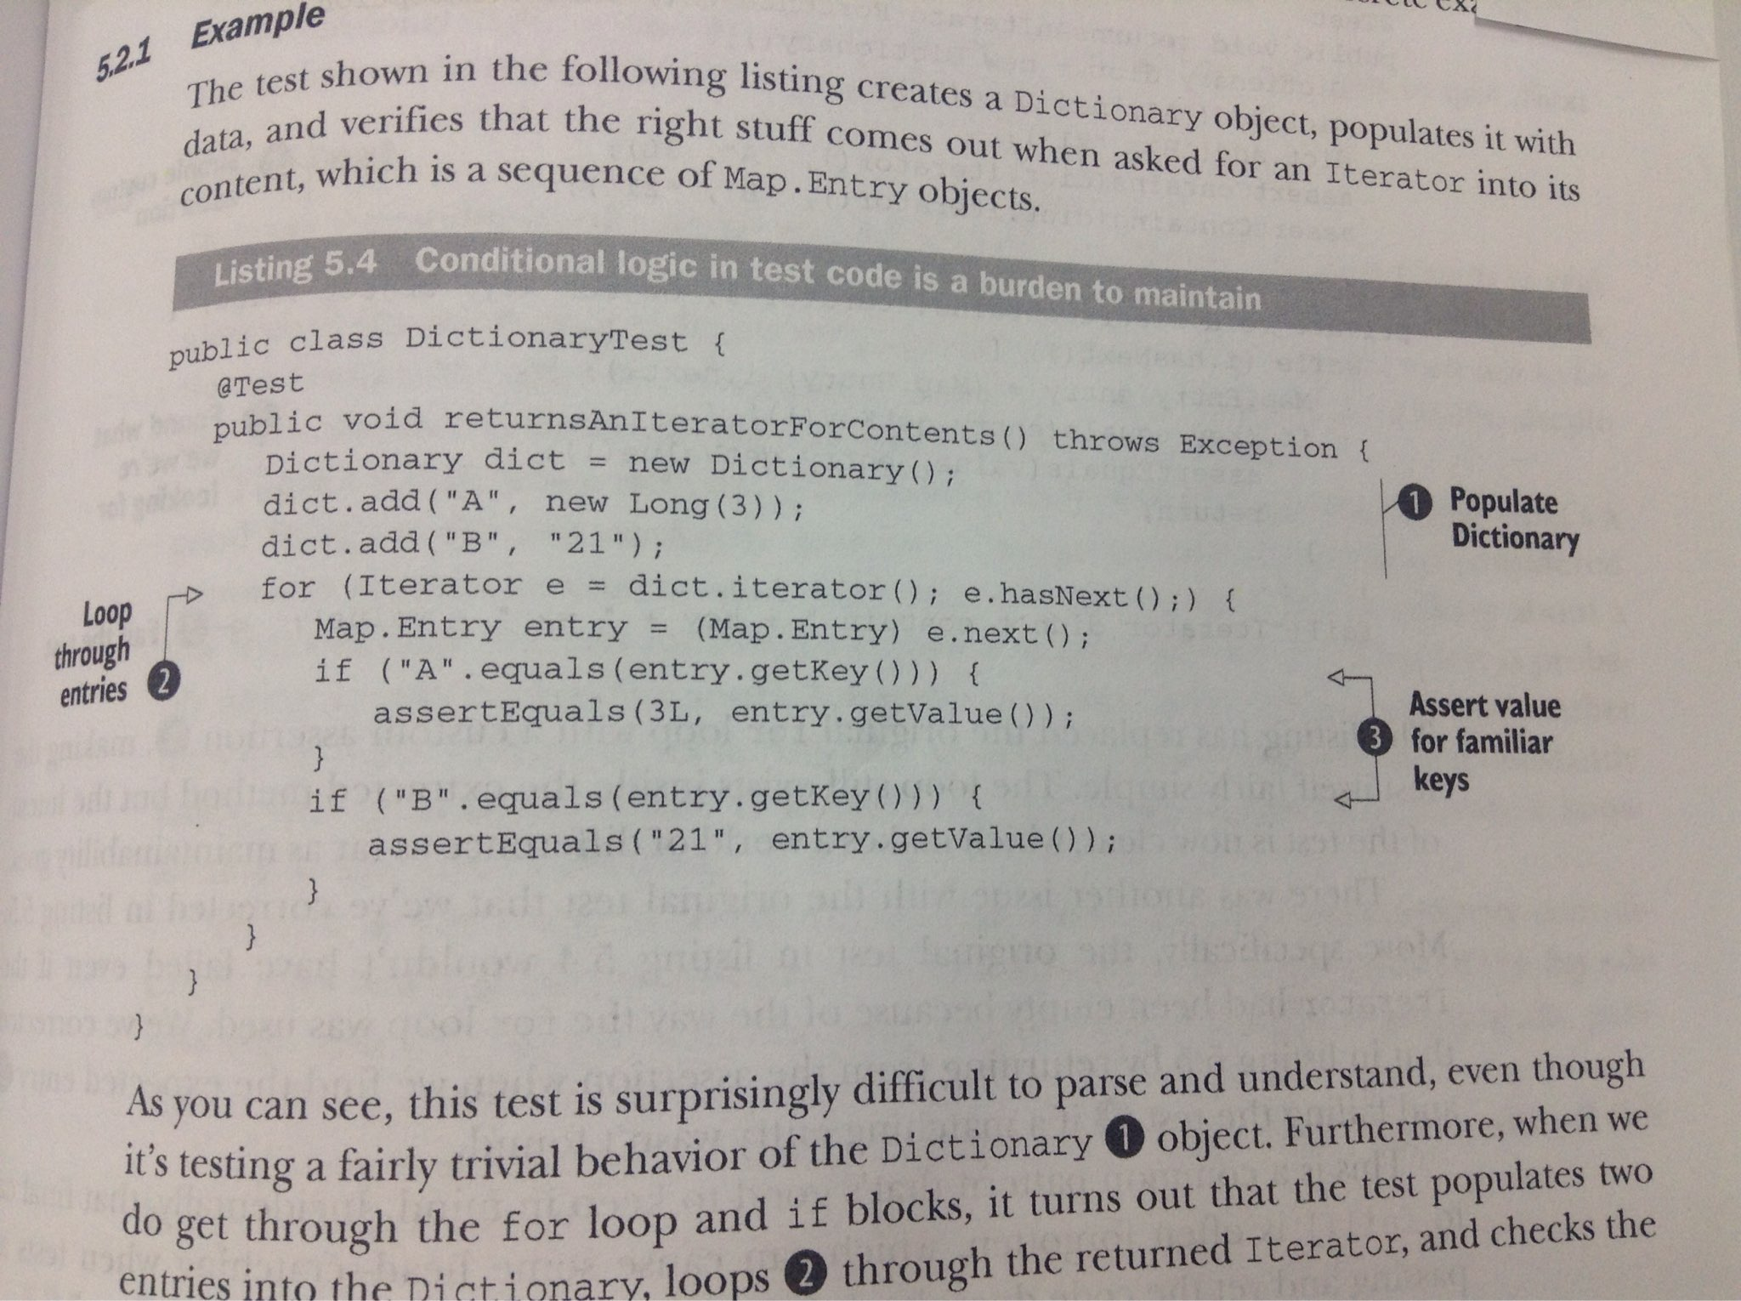
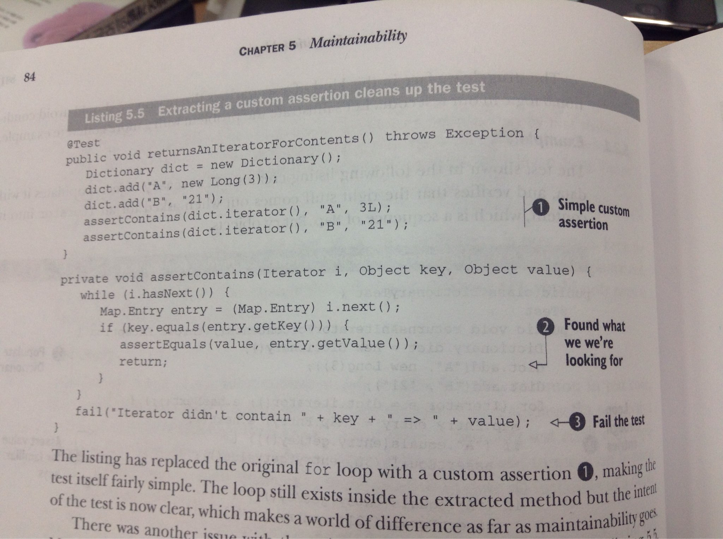

Slide 62
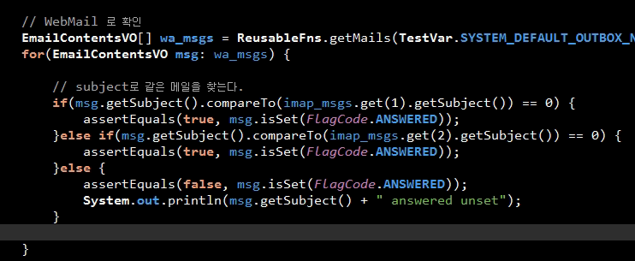
Conditional Logic

Slide 63
그 외
Maintainability
Flaky Test
Flaky test: fails intermittently
Crippling file path
getClass().getResource().getFile()
project’s root directory 기준으로 상대경로 사용
Persistent temp files
Lack of cohesion in methods
if tests work on different fixtures, they should be refactored into more than one test class.

Slide 64
public class USEWA051_01 extends DefaultEmailConfig {

Slide 65
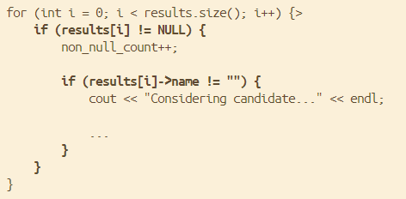
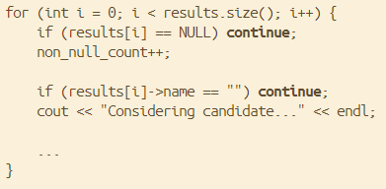
Removing Nesting Inside Loops
failure case를 먼저 다루고 early return을 사용함으로써 nest if를 없앨 수 있다.
if (user_result != SUCCESS) {
reply.WriteErrors( user_result); r
eply.Done();
return;
}

Slide 66
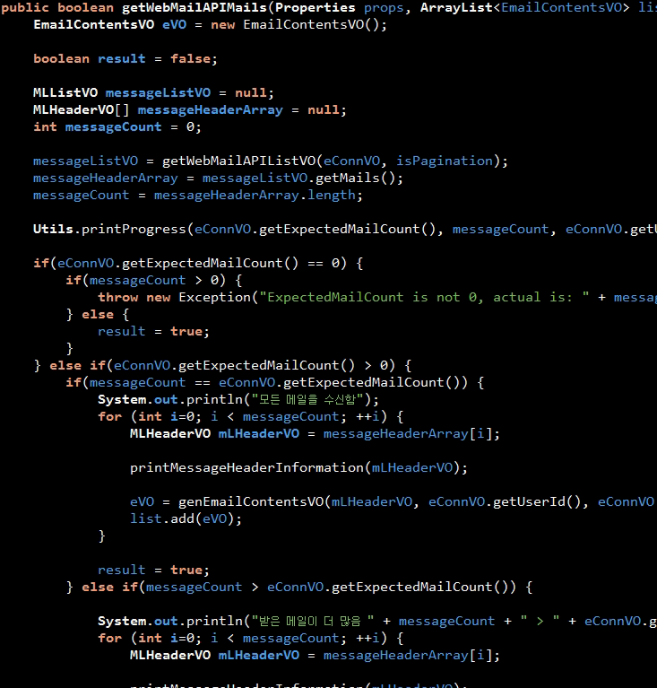
return true;

Slide 67
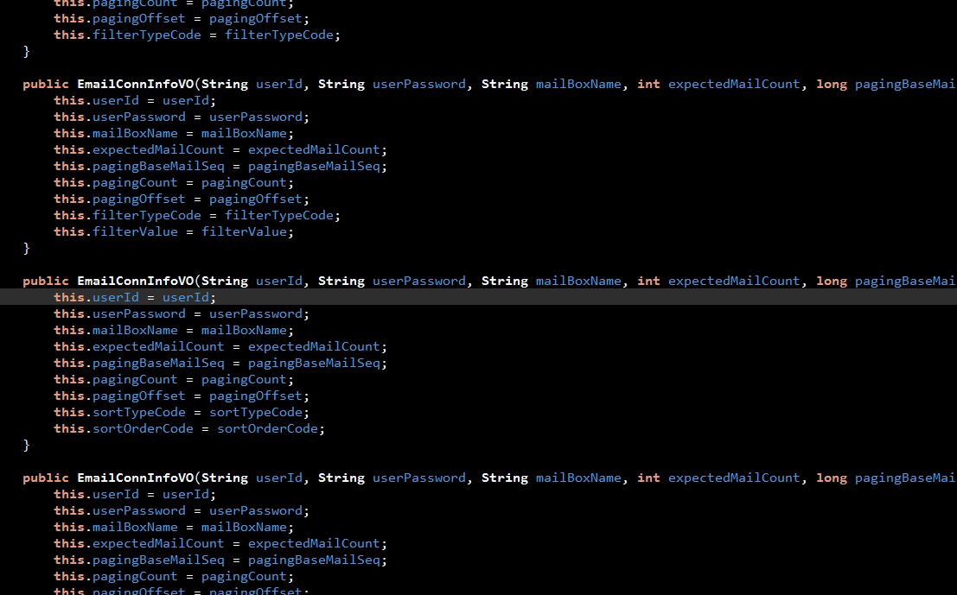
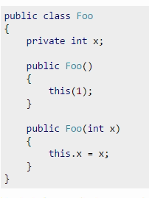

Slide 68
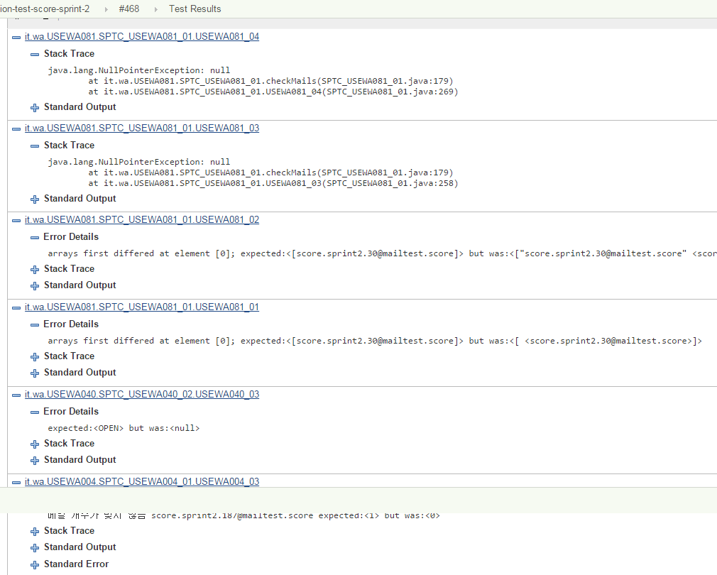

Slide 69
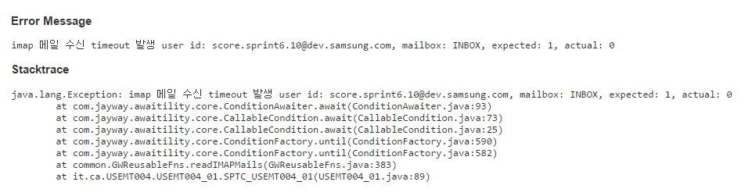
mailid 추가 예정

Slide 70
제안
향후 테스트
Test Code Readability 개선
assertThat
코드를 간결하게
Extract Method
Random Test Data 사용 금지
기존 코드 리팩토링
Don't Put Logic in Tests
duplication 제거
Extract Method
문제점 식별 빠르게...
수신 확인과 다른 동작(필터링 등) 확인을 분리
문제가 되는 mail id 출력
class/method name을 조정할 수 없으므로 좀 제약적이나...

Slide 71
제안 - 기타
Parameters 사용
테스트 수행 속도 개선을 위해 병렬 수행
sieve 테스트 실패 시 sieve 룰 출력

